Slide 1
Telecom Churn Case Study

Slide 2
Problem Statement
Reading and understanding the data
Data Preparation
Data Cleaning
Exploratory Data Analysis
Plots of important predictors for churn and non-churn customers

Slide 3
Problem Statement
In the telecom industry, customers are able to choose from multiple service providers and actively switch from one operator to another. In this highly competitive market, the telecommunications industry experiences an average of 15-25% annual churn rate. Given the fact that it costs 5-10 times more to acquire a new customer than to retain an existing one, customer retention has now become even more important than customer acquisition.
For many incumbent operators, retaining high profitable customers is the number one business goal.
To reduce customer churn, telecom companies need to predict which customers are at high risk of churn.

Slide 4
Reading and understanding the data
Here we are given with 4 months of data related to customer usage. In this case study, we analyze customer-level data of a leading telecom firm, build predictive models to identify customers at high risk of churn and identify the main indicators of churn.
Churn is predicted using two approaches. Usage based churn and Revenue based churn. Usage based churn:
Customers who have zero usage, either incoming or outgoing - in terms of calls, internet etc. over a period of time.
This case study only considers usage based churn.
In the Indian and the southeast Asian market, approximately 80% of revenue comes from the top 20% customers (called high-value customers). Thus, if we can reduce churn of the high-value customers, we will be able to reduce significant revenue leakage. Hence, this case study focuses on high value customers only.
The dataset contains customer-level information for a span of four consecutive months - June, July, August and September. The months are encoded as 6, 7, 8 and 9, respectively.

Slide 5
Data Preparation
The following data preparation steps are crucial for this problem:
1. Filter high-value customers
Those who have recharged with an amount more than or equal to X, where X is the 70th percentile of the average recharge amount in the first two months (the good phase). After filtering the high-value customers, we should get about 30k rows.
2. Tag churners and remove attributes of the churn phase
Now tag the churned customers (churn=1, else 0) based on the fourth month as follows: Those who have not made any calls (either incoming or outgoing) AND have not used mobile internet even once in the churn phase. The attributes you need to use to tag churners are:
total_ic_mou_9
total_og_mou_9
vol_2g_mb_9
vol_3g_mb_9

Slide 6
Data Cleaning
We have started with importing Necessary packages and libraries.
We have loaded the dataset into a data frame.
We have checked the number of columns, their data types, Null count and unique value_value_count to get some understanding about data and to check if the columns are under correct data-type.
Checking for duplicate records (rows) in the data. There were no duplicates.
Since 'mobile_number' is the unique identifier available, we have made it our index to retain the identity.
Have found some columns that do not follow the naming standard, we have renamed those columns to make sure all the variables follow the same naming convention.
Following with column renaming, we have dealt with converting the columns into their respective data types. Here, we have evaluated all the columns which are having less than or equal to 29 unique values as categorical columns and rest as continuous columns.
The date columns were having 'object' as their data type, we have converted to the proper datetime format.

Slide 7
The date columns were having 'object' as their data type, we have converted to the proper datetime format.
Since, our analysis is focused on the HVC(High value customers), we have filtered for high value customers to carryout the further analysis. The metric of this filtering of HVC is such that all the customers whose 'Average_rech_amt' of months 6 and 7 greater than or equal to 70th percentile of the 'Average_rech_amt' are considered as High Value Customers.
Checked for missing values.
Dropped all the columns with missing values greater than 50%.
We have been given 4 months data. Since each months revenue and usage data is not related to other, we did month-wise drill down on missing values.
Some columns had similar range of missing values. So, we have looked at their related columns and checked if these might be imputed with zero.
We have found that 'last_date_of_the_month' had some missing values, so this is very meaningful and we have imputed the last date based on the month.
We have found some columns with only one unique value, so it is of no use for the analysis, hence we have dropped those columns.
Once after checking all the data preparation tasks, tagged the Churn variable(which is our target variable).
After imputing, we have dropped churn phase columns (Columns belonging to month - 9).

Slide 8
Exploratory Data Analysis
The telecom company has many users with negative average revenues in both phases. These users are likely to churn.
Most customers prefer the plans of '0' category.
The customers with lesser 'aon' are more likely to Churn when compared to the Customers with higher 'aon'.
Revenue generated by the Customers who are about to churn is very unstable.
The Customers whose arpu decreases in 7th month are more likely to churn when compared to ones with increase in arpu.
The Customers with high total_og_mou in 6th month and lower total_og_mou in 7th month are more likely to churn compared to the rest.
The Customers with decrease in rate of total_ic_mou in 7th month are more likely to churn, compared to the rest.
Customers with stable usage of 2g volume throughout 6 and 7 months are less likely to churn.
Customers with fall in usage of 2g volume in 7th month are more likely to Churn.
Customers with stable usage of 3g volume throughout 6 and 7 months are less likely to churn.
Customers with fall in consumption of 3g volume in 7th month are more likely to Churn.
The customers with lower total_og_mou in 6th and 8th months are more likely to Churn compared to the ones with higher total_og_mou.
The customers with lesser total_og_mou_8 and aon are more likely to churn compared to the one with higher total_og_mou_8 and aon.
The customers with less total_ic_mou_8 are more likely to churn irrespective of aon.
The customers with total_ic_mou_8 > 2000 are very less likely to churn.

Slide 9
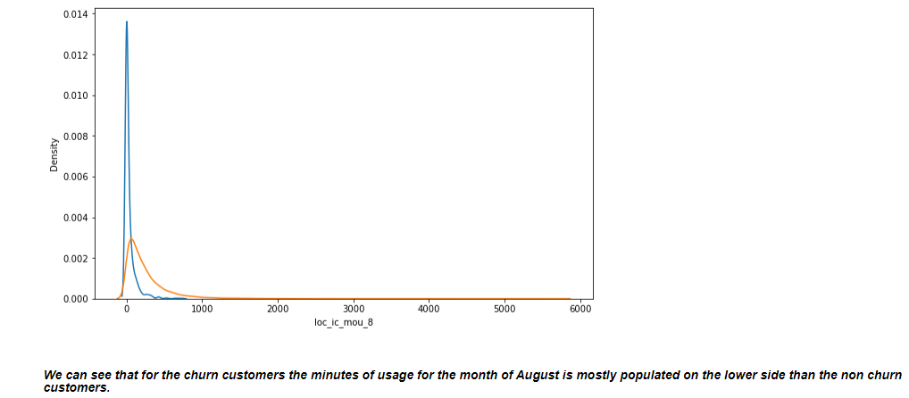
Plots of important predictors for churn and non-churn customers

Slide 10
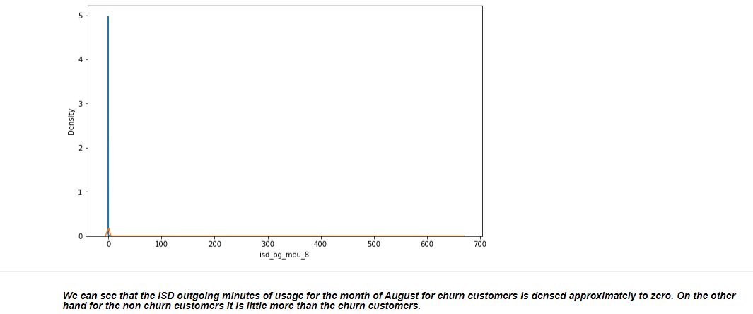

Slide 11
